Slide 1
Revision exercises 1: verb tenses
This presentation contains grammar explanations, exercises and solutions.
Do not check the answers until you have finished each exercise. Self-evaluate yourself.
What are your main problems with tenses? Send your comments to the Grammar forum

Slide 2
Advanced Grammar in Use, Units 1-10
The following activities provide further practice of verb tenses and are taken from two sources:
Hewings, M. 2013. Advanced Grammar in Use. Cambridge: C.U.P. (Additional Exercises Section). (Henceforth, AGiU).
Swan, M & C. Walter. 2011. Oxford English Grammar Course. Advanced. Oxford: O. U. P. (Henceforth, OEGC)
Each exercise covers grammar from two or more units of AGiU.
A key is included. Do the exercises, check your answers, and, if you have problems to understand them, refer to the corresponding units.

Slide 3
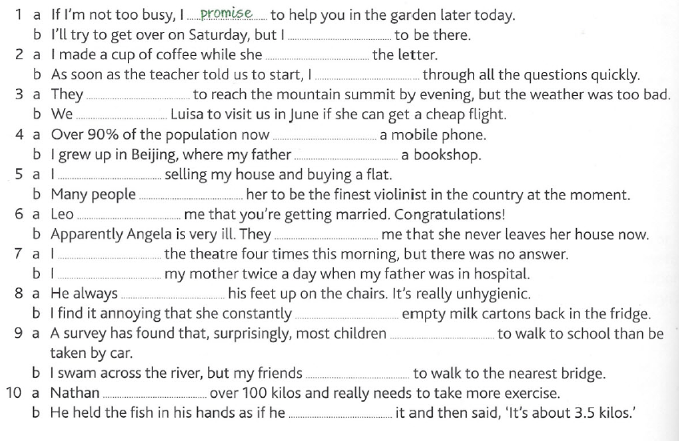
Exercise 1 (AGiU, p. 240)
Complete each pair of sentences with a positive or negative form of the same verb from the box. Use the present simple, present continuous, past simple or past continuous. Give all possible answers.

Slide 4
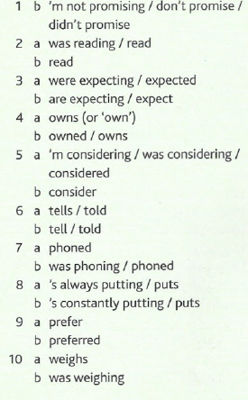

Exercise 1 (AGiU, p. 278)
Check your answers to the previous exercise:
ANY PROBLEMS?
CHECK UNITS 1, 2, & 4 OF AGIU
(Present & Past; Simple and Continuous).

Slide 5
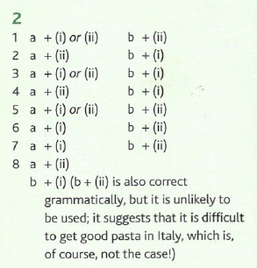
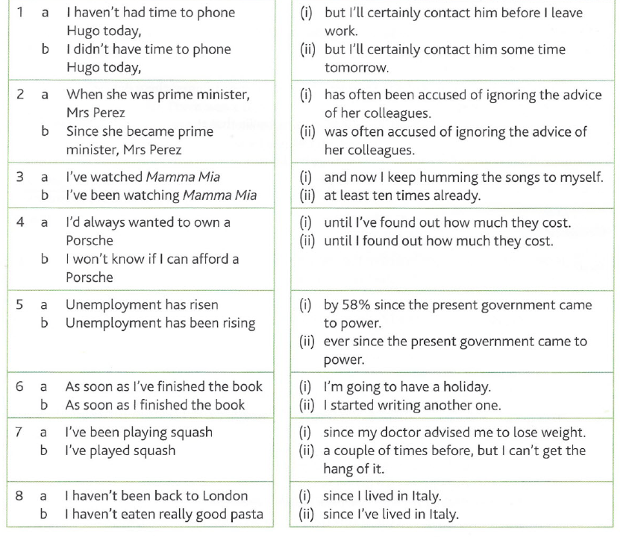

Exercise 2 (AGiU, p. 241)
Match the beginnings and endings. Sometimes there is more than one possibility.
Check your answers (AGIU, p. 278)
ANY PROBLEMS?
CHECK UNITS 3 & 6 OF AGIU
(Present Perfect, Past Simple and Present Perfect Continuous).

Slide 6
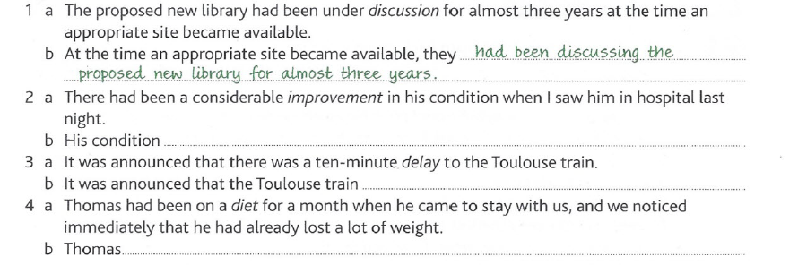
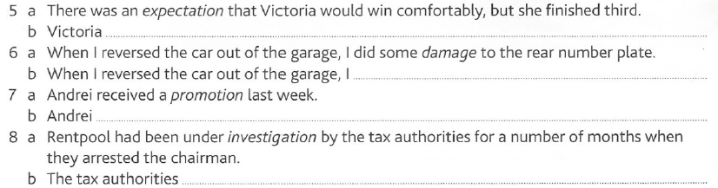
Exercise 3 (AGiU, p. 241-2)
Complete each sentence (b) so that it has a similar meaning to sentence (a). Use a verb related to the italicized word in an appropriate tense (active or passive): past perfect, past perfect continuous or past simple. Give alternatives where possible.

Slide 7
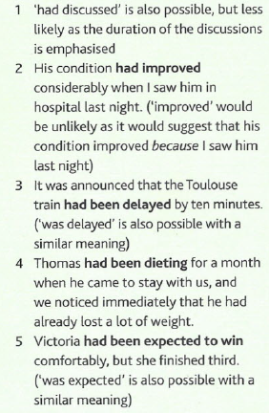
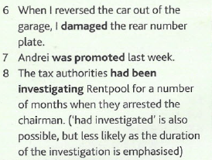
Exercise 2 (AGiU, p. 278)
Check your answers to the previous exercise:
ANY PROBLEMS?
CHECK UNITS 5 & 7 OF AGIU
(Past perfect, past perfect continuous, and past simple).

Slide 8
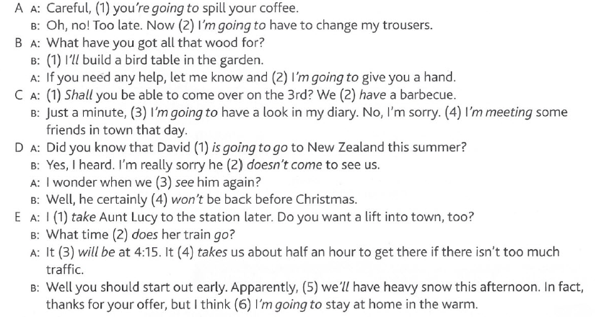
Exercise 4 (AGiU, p. 242)
If necessary, correct or improve the italicised verbs in these dialogues, using will, shall, going to, present continuous for the future, or present simple for the future.

Slide 9
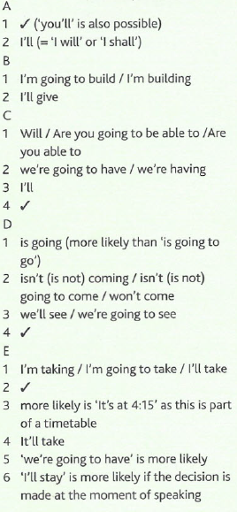
Exercise 4 (AGiU, p. 242)
Check your answers (AGIU, p. 278)
ANY PROBLEMS?
CHECK UNITS 9 & 10 OF AGIU
(The future).

Slide 10
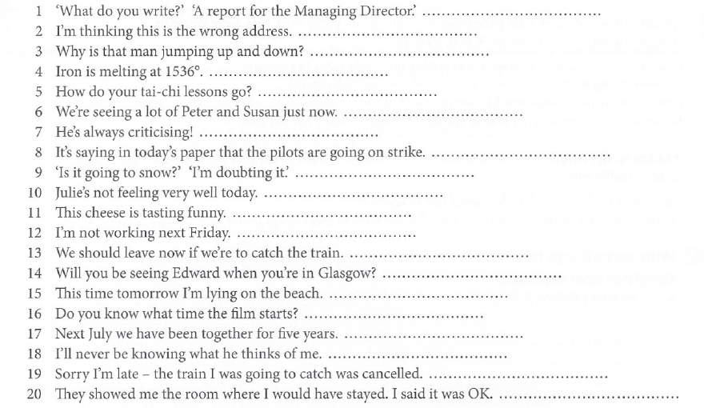
Exercise 5 (OEGC, p. 38)
Correct the mistakes or write ‘correct’.

Slide 11
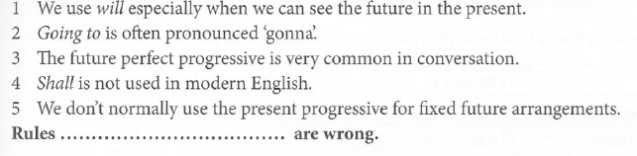
Exercise 6 (OEGC, p. 39)
Do it yourself. Which of these rules are wrong?

Slide 12
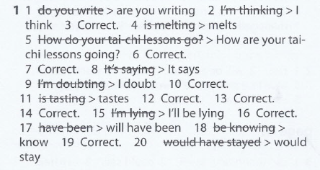
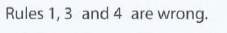
Exercises 5 & 6 (OEGC, p. 38)
Check your answers (OEGC, p. 315)
Ex. 5
Ex. 6
ANY PROBLEMS?
CHECK UNITS 1, 2 & 9-11 OF AGIU
(Present & future tenses).

Slide 13
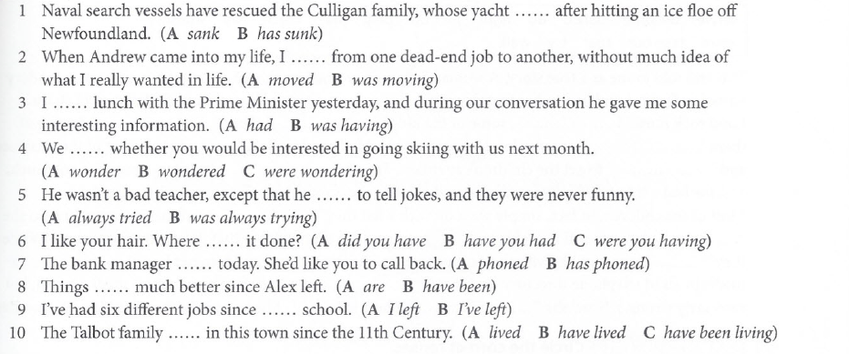
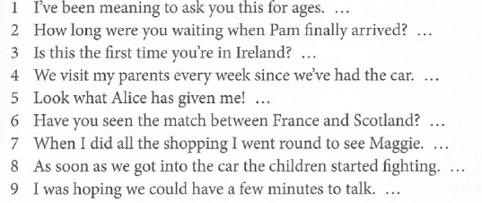
Exercise 7 (OEGC, p. 55)
A) Which is/are correct or normal: A, B, (C) or both/all three?
B) Correct or not?

Slide 14
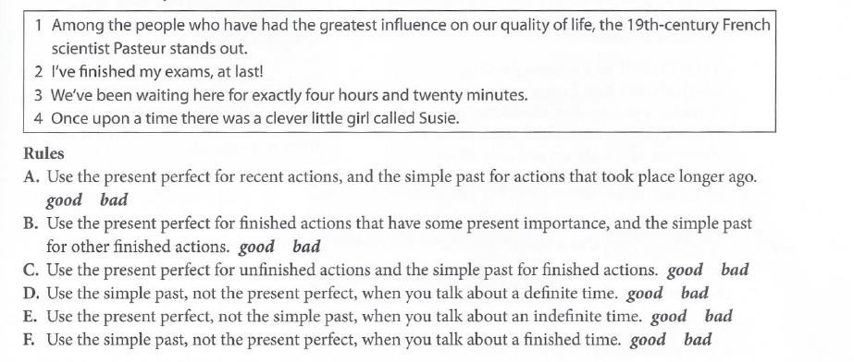
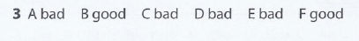
Exercise 8 (OEGC, p. 55)
Here are four examples of correct use and six rules. Four rules are bad. Look at the examples and decide which?

Slide 15
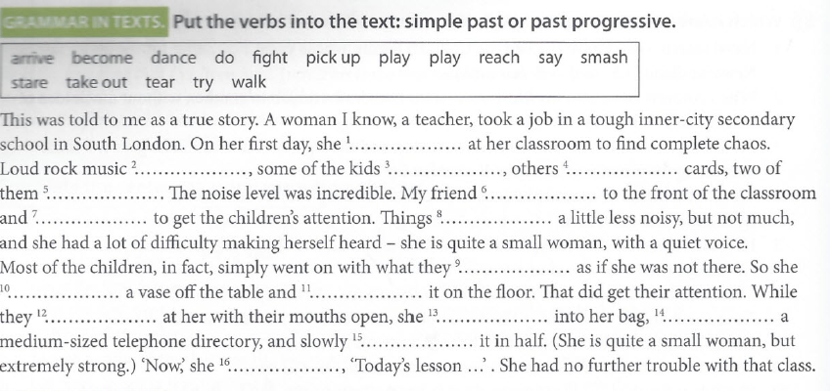
Exercise 9 (OEGC, p. 56)

Slide 16
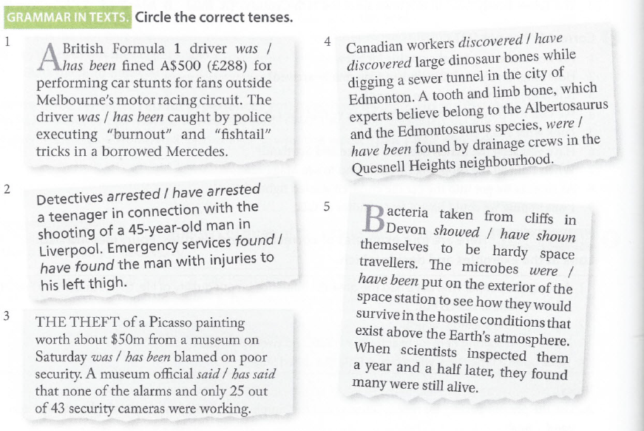
Exercise 10 (OEGC, p. 56)

Slide 17
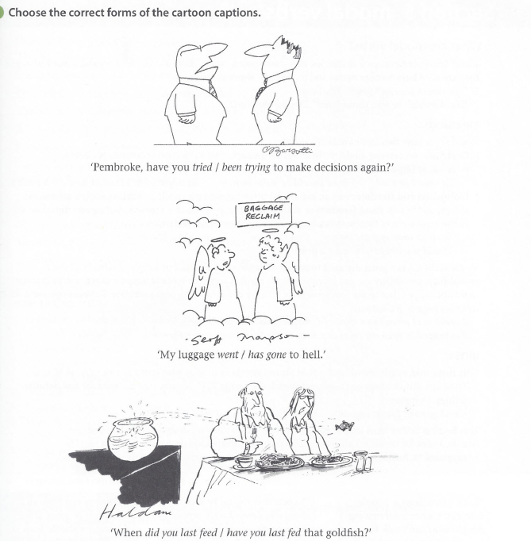
Exercise 11 (OEGC, p. 56)

Slide 18
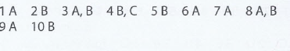
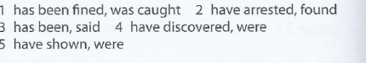
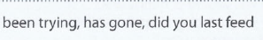
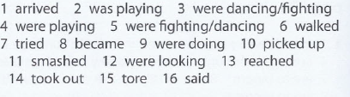
Exercises 7-11 (OEGC, p. 55)
Check your answers (OEGC, p. 316)
Ex. 7A
Ex. 10
Ex. 7B
Ex. 11
Ex. 8
Ex. 9
ANY PROBLEMS?
CHECK UNITS 3-7 OF AGIU
(Past tenses).

